Slide 1
Coding Pandas Final Report
Lang Shao
one of the pandas

Slide 2
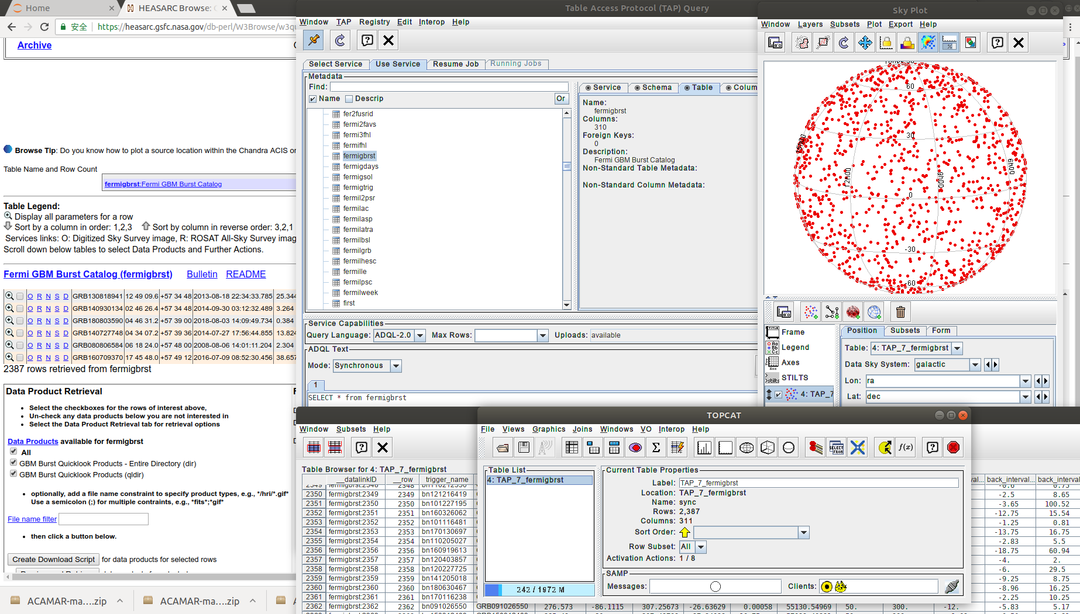
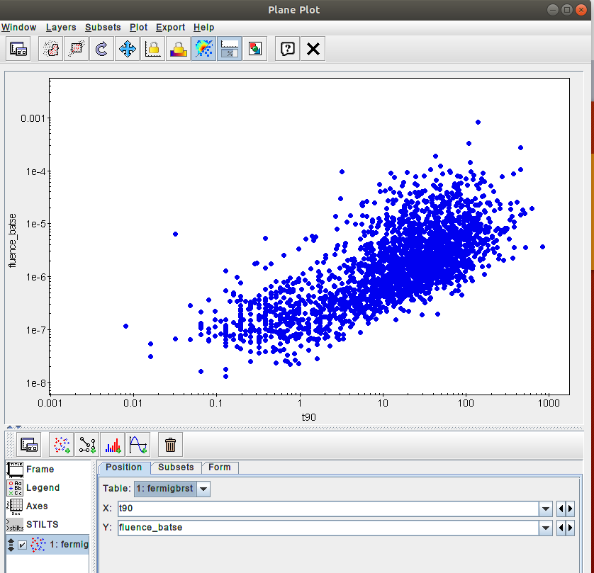
Exploratory Data Analysis with topcat & Python

Slide 3
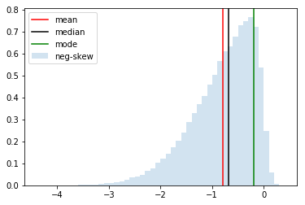
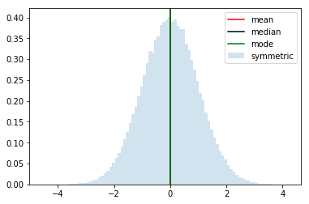
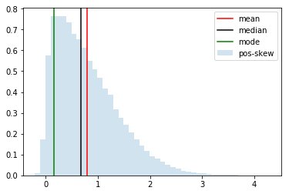
Skewness and Central tendency with numpy, scipy and matplotlib
Negatively Skewed
Symmetric
Positively Skewed
mean < median < mode
mean == median == mode
mode < median < mean

Slide 4
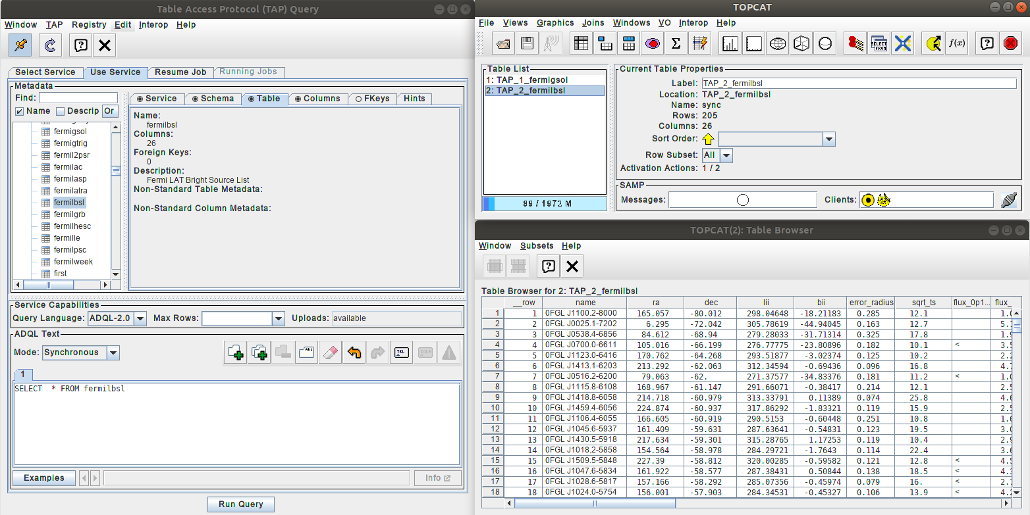
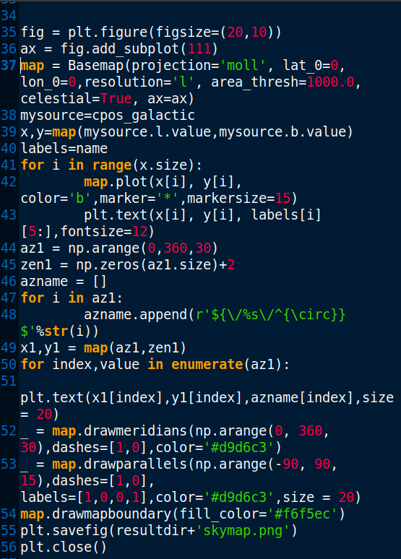
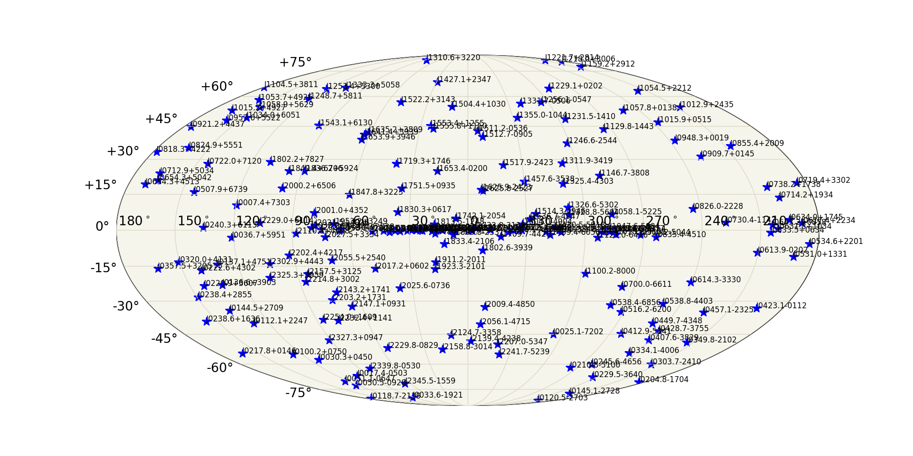
SQL query with topcat / show catalog with basemap

Slide 5
